Slide 1

Analysis 1: Foundations of Modeling Lesson 6.1: Problem solving with Venn diagram
Analysis Team, 2020/2021

Slide 2
Overview of this lesson: Problem solving with Venn diagram
Venn diagram and Boolean algebra,
Problem solving with Venn diagram,
Categorical proposition

Slide 3
Overview of this lesson: Problem solving with Venn diagram
Learning objectives:
Learn how to represent Boolean algebra relations and categorical propositions with Venn diagram.
Learn how to use Venn diagram for proving validity of syllogisms.
At the end of the lesson a student should be able to:
Apply Venn diagram in problem solving.
Determine the validity of syllogism using Venn diagram.

Slide 4
Venn diagram and Boolean algebra

Slide 5
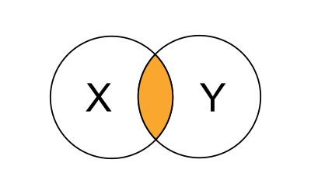
Venn diagram and Boolean algebra
In the previous lesson we learned about Boolean algebra and Boolean operators. We can address the same examples and demonstrate how Venn diagram improve the clarity.
AND operator – “you will get a passing grade for this course if you pass the test AND pass the assignment.”
x – represents if you pass test.
y – represents if you pass assignment.
z – represents if you get the passing
grade for this course.
z = x AND y

Slide 6
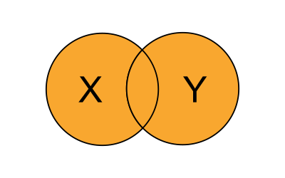
Venn diagram and Boolean algebra
OR operator – “you will miss the class if you wake up late OR there is a traffic jam.”
x – represents if you wake up late.
y – represents if there is a traffic jam.
z – represents if you miss the class.
z = x OR y

Slide 7
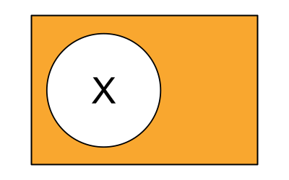
Venn diagram and Boolean algebra
NOT operator – “you will go by bike if it is NOT raining”
x – represents if it is raining.
z – represents if you go by bike.
z = NOT x

Slide 8
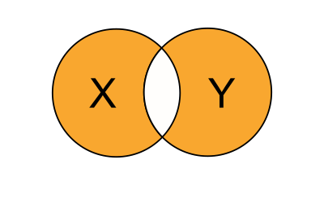
Venn diagram and Boolean algebra
Please note: there is no 1-to-1 matching between linguistics and Boolean algebra. In linguistics we often lack means to precisely distinguish between conditions as we can do in Boolean algebra. Hence, some statements may sound … ‘weird’
XOR operator – “you will order coffee (x)OR tea.”
x – represents if you order coffee.
y – represents if you order tea.
z – represents if you order either
coffee or tee BUT NOT BOTH.
z = x XOR y

Slide 9
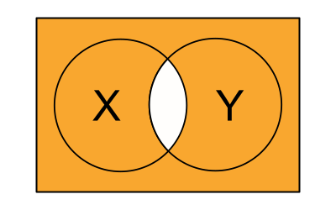
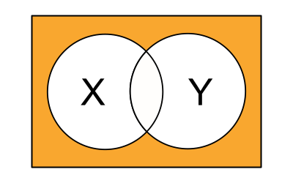
Venn diagram and Boolean algebra
NAND
NOR

Slide 10
Problem solving with Venn diagram

Slide 11
Problem solving with Venn diagram
Venn diagram allow easy identification of relationship between collections of sets.
The overlapping area (intersection) describe the common elements.
Areas that are not overlapping (difference) describe unique elements.
common
for both
sets
only in
set 1
only in
set 2

Slide 12
Problem solving with Venn diagram (example)
subjects that I love
gaming
English
How to build
a snowman
Analysis 1
databases
Latin
Dev 1
subjects that are useful
subjects that are taught well

Slide 13
Problem solving with Venn diagram (problem 1)
There are 20 students in the classroom. 15 students know how to program in Python. 10 students know Boolean algebra. 5 students know both to program in Python and Boolean algebra.
How many students know how to program in Python?
How many students that program in Python don’t know Boolean algebra?

Slide 14
Problem solving with Venn diagram (problem 1)
There are 20 students in the classroom. 15 students know how to program in Python. 10 students know Boolean algebra. 5 students know both to program in Python and Boolean algebra.
Draw Venn Diagram,
Start backwards – with intersection,
Programmers only: 15 – 5 = 10,
Boolean algebra only: 10 – 5 = 5.
P
B
10
5
5

Slide 15
Problem solving with Venn diagram (problem 1)
How many students know how to program in Python?
10 + 5 = 15
(already given in problem)
How many students that program in Python don’t know Boolean algebra?
10
P
B
10
5
5

Slide 16
Problem solving with Venn diagram (problem 2)
There are 30 students in the classroom. 15 students know how to program in Python. 13 students know Boolean algebra. 10 students can’t program and don’t know Boolean algebra.
How many students know both Python programming and Boolean algebra?

Slide 17
Problem solving with Venn diagram (problem 2)
Universal set
There are 30 students in the classroom. 15 students know how to program in Python. 13 students know Boolean algebra. 10 students can’t program and don’t know Boolean algebra.
We need universal set. 10 students are not in P and not in B.
We can write: |P| = p + x = 15,
|B| = b + x = 13
We know that:
p + b + x = 30 – 10 = 20
p + b + 2x = 15 + 13 = 28
→ x = 8, p = 13-8=7, b = 13-8=5
P
(15)
B
(13)
p
X
8
b
7
5
10

Slide 18
Problem solving with Venn diagram (problem 2)
Universal set
How many students know both Python programming and Boolean algebra?
8
P
(15)
B
(13)
7
8
5
10

Slide 19
Problem solving with Venn diagram (exercise 3)
There are 100 Informatica students in total, studying Analysis (A), Project (P) and Development (D).
49 students passed Analysis exam,
39 students completed Project,
31 students passed Development exam,
9 passed Analysis and Project,
13 passed Analysis and Development,
14 passed Development and Project,
5 managed to complete all three exams.
How many students failed all exams?
How many students passed Analysis only (but not Project and Dev.)?
How many students passed Dev. and Project, but not Analysis?

Slide 20
Problem solving with Venn diagram (exercise 3 - solution)
A
U
32
P
4
8
D
5
21
9
9
12
Notes:
Answers:
1: How many students failed all exams? 12
2: How many students passed Analysis only (but not Project and Dev.)? 32
3: How many students passed Dev. and Project, but not Analysis? 21 + 9 + 9 = 39

Slide 21
Categorical proposition

Slide 22
Categorical proposition
A Categorical proposition (= categorical statement) is a statement about the relationship between categories.
A categorical proposition states: whether one category is:
fully contained in another category,
partially contained within another category,
completely separate.
Examples:
All teachers are programmers.
Some teachers are friendly.
No teacher is a millionaire.

Slide 23
Categorical proposition
Propositions may have quality and quantity:
Quality: affirmative or negative
Quantity: particular (some), universal (all)
The first term in the proposition is the subject (typically labeled as S).
The second term in the proposition is the predicate (typically P).
Example: “Some dogs are friendly”.
S: dogs
P: friendly
some S are P

Slide 24
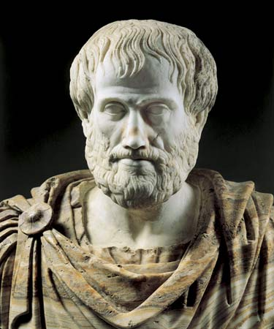
Categorical proposition
Aristotle (384 – 322 BC) identified four primary distinct types of categorical proposition.
He gave them the standard forms now referred to A, E, I, O.
A: All S are P.
E: No S are P.
I: Some S are P.
O: Some S are not P.

Slide 25
Standard form
Natural language sentences can be translated into standard form.
Name |  | Sentence (example) | Standard form
A | Affirmo | “All cats have tail.” | All S is P.
E | nEgo | “No human has wings.” | No S is P.
I | affIrmo | “Some dogs are friendly.” | Some S is P.
O | negO | “Some teachers are not gamers.” | Some S is not P.

Slide 26
Standard form
Each form has its quantity and quality.
Name | Standard form | Quantity | Quality
A | All S is P. | universal | affirmative
E | No S is P. | universal | negative
I | Some S is P. | particular | affirmative
O | Some S is not P. | particular | negative

Slide 27
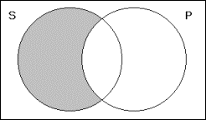
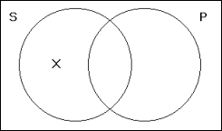
Representing categorical proposition with Venn diagram
Venn diagram are very effective to represent categorical propositions. Two rules apply:
shading a region indicates that that region is empty
placing and an X in a region indicates it is not empty (some)

Slide 28
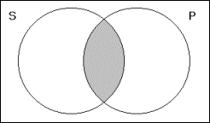
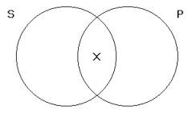
Representing categorical proposition with Venn diagram
A: All S are P.
I: Some S is P.
E: No S is P.
O: Some S is not P.

Slide 29
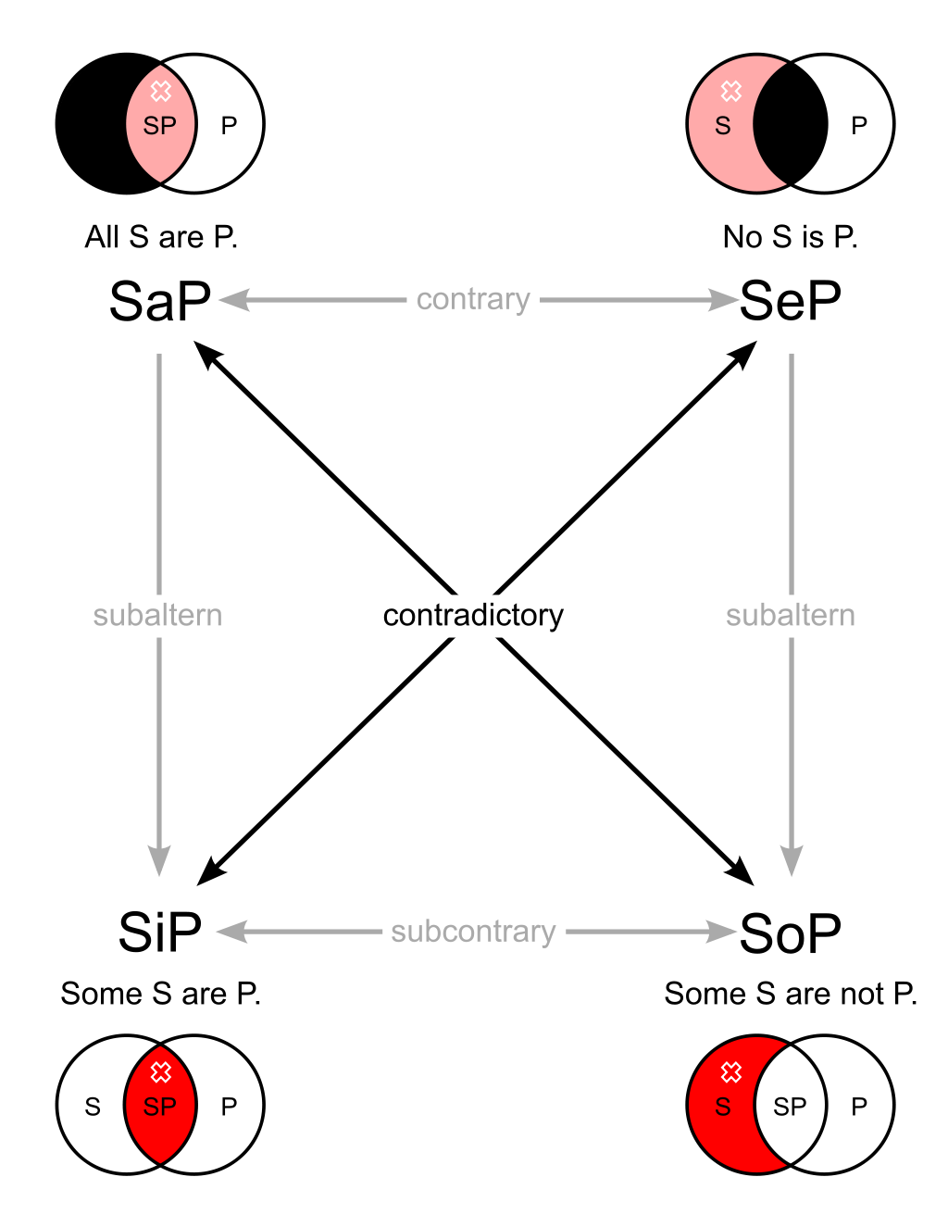
Notes:
Image source: Wikipedia (https://en.wikipedia.org/wiki/Square_of_opposition)
Image author: Watchduck (a.k.a. Tilman Piesk)
Copyright: public domain

Slide 30
Solving syllogism with Venn diagram

Slide 31
Represent syllogism with Venn diagram
With Venn diagram we can visualize logical relationships between a subject and a predicate in a categorical claim.
Steps:
Draw Venn diagram to represent all terms.
Shade or mark with an X the appropriate areas according to the categorical claims in the premises.
Assert if the conclusion is contained within the appropriate area.
IF the conclusion is contained within the appropriate area and doesn’t require adding additional information → conclusion is valid,
ELSE the conclusion is invalid.

Slide 32
Syllogism 1
H
All teachers are human.
No humans are perfect.
Therefore, no teachers are perfect.
The conclusion is VALID.
(there is no T in P)
T
P

Slide 33
Syllogism 2
F
Some footballers are gamers.
All footballers are human.
Therefore, some humans are gamers.
The conclusion is VALID.
(there are some (X) H in G)
X
H
G

Slide 34
Syllogism 3
S
Some Rebels use Force.
No stormtroopers use Force.
Therefore, some stormtroopers are not Rebels.
The conclusion is NOT VALID.
(there is no X in the region specifying S is not R)
?
X
F
R

Slide 35
Summary Quiz
What is categorical proposition?
How many standard forms of categorical propositions exist, and what are those?

Slide 36
Summary
Categorical proposition is a statement about the relationship between categories. It consists of a subject and a predicate, and show quality and quantity.
There are four standard forms:
A – all S are P (universal affirmative)
E – no S is P (universal negative)
I – some S is P (particular affirmative)
O – some S is not P (particular negative)

Slide 37
Extra material - videos
Disclaimer:
The following videos are not part of the course material, and as such, are treated as an extra information. The teaching team believes it is beneficial to the students to also have the topics presented from a different perspective. Some video will provide more information that given at the lesson, some less.
For the exam, the only relevant information is considered the one given by the teachers and written in the course book.
To understand the topics better, using external sources, like the videos given below, is strongly recommended. Feel free to explore, and ask your teacher should you have any questions.

Slide 38
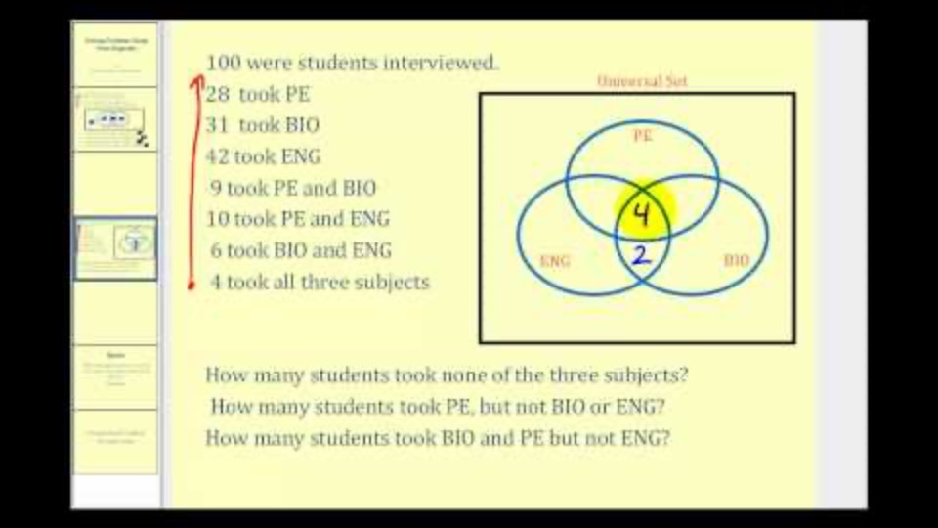
Solving problems with Venn diagrams
Notes:
URL:
https://www.youtube.com/watch?v=MassxXy8iko

Slide 39
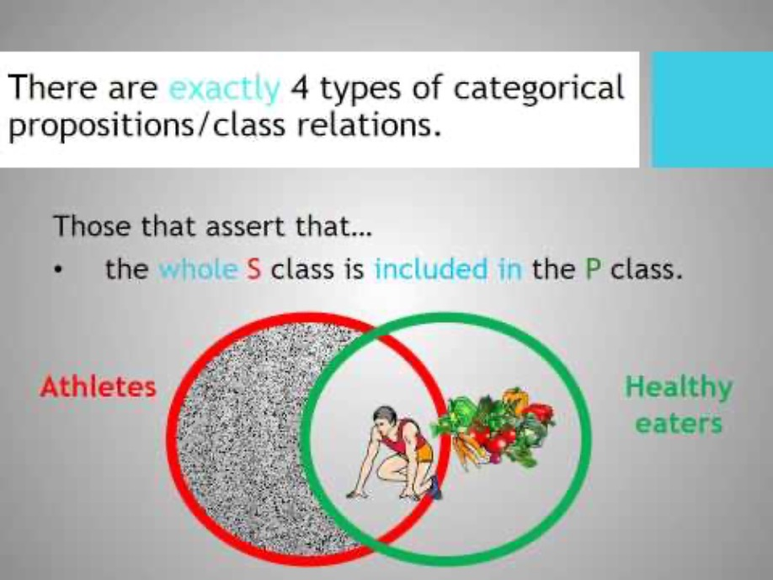
Categorical statements
Notes:
URL:
https://www.youtube.com/watch?v=5yfxogMakGo

Slide 40
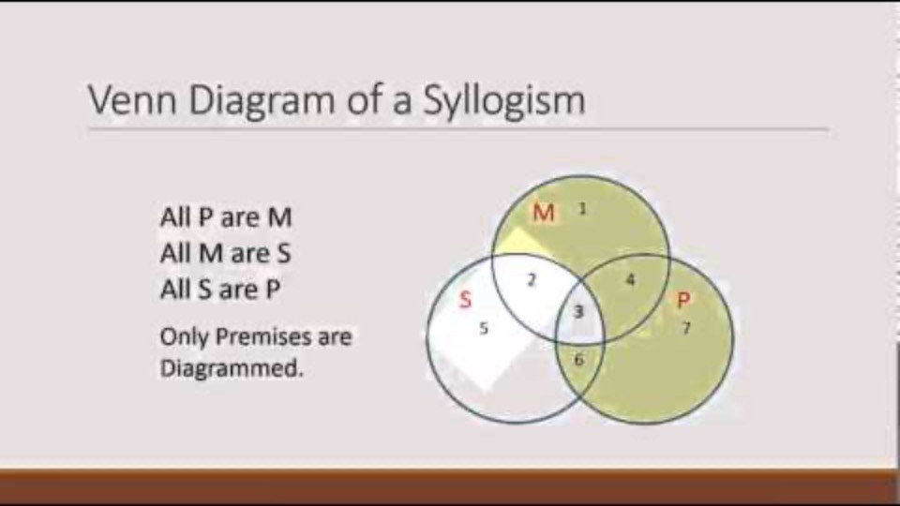
Venn diagrams and testing validity
Notes:
URL:
https://www.youtube.com/watch?v=rcyeHdx0Qv4

